Slide 1
Capstone Project: Battle of Neighbourhood Singapore (week2)
B.Kokularaj

Slide 2
Introduction
Idea of this project is - If a business person want to open a restaurant in Singapore, help him/her analyse which area would be better depending on competition in Singapore

Slide 3
Data
postal districts data gained from https://en.wikipedia.org/wiki/Postal_codes_in_Singapore#6-digit_postal_code
With Four square API, nearby venues within Singapore Were found

Slide 4
Methodology
This project will check the density of restaurants in Singapore postal districts.
Plot bar charts for restaurants in Singapore postal districts. Plot bar chart for % of Restaurants around the Singapore.

Slide 5
Results

Slide 6
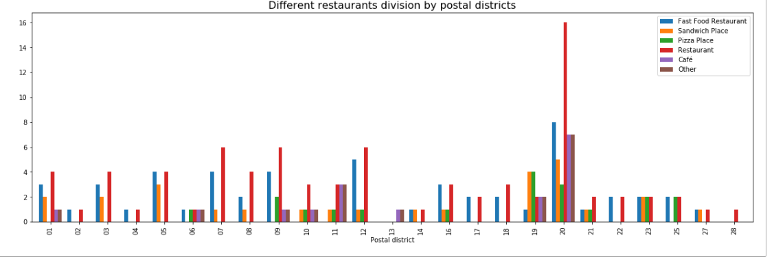
Restaurants counts for all postal districts of Singapore

Slide 7
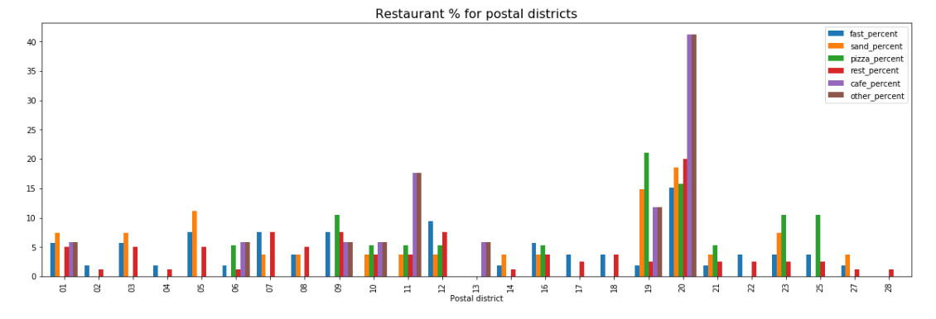
percentage of Restaurants for postal districts

Slide 8
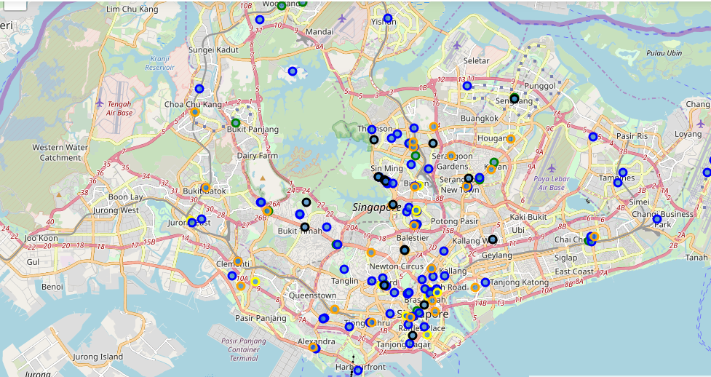
Map
Fast Food Restaurant- Red
Sandwich Place – Orange
Pizza Place –Green
Restaurant-Blue
Café-Black
Other-Yellow

Slide 9
Conclusion
Assuming increasing population in Singapore most and import place to open a restaurant is Postal district 12. Therefore best place to open a restaurant are Balestier, Toa Payoh, Serangoon. My best preference is Serangoon for open a restaurant.

